Slide 1
Course Introduction
CS 1181 – Computer Science II
Dr. Michael Raymer
Lecture materials adapted from:
ZyBooks ISBN: 979-8-203-16123-9 Dr. Cay Horstmann, Univ. of Michigan Dr. Roman Lysecky, Univ. of Arizona
Dr. Adrian Lizarraga, Univ. of Arizona
Dr. Travis Doom
Dr. Michelle Cheatham
Unless otherwise noted images are used under the creative commons license or used under license from Adobe Stock.

Slide 2
What is this class about?
Why should you care?

Slide 3
This is not a Java course
Although we will learn a lot of Java.
This is not a programming course
Although we will do a lot of programming
This is a computer science course
We will learn how programs and computers work

Slide 4
This course is immersive
Weekly reading and homework
Weekly quizzes
Labs are required
Weekly practice problems
Four major programming projects
Comprehensive final exam

Slide 5

This course is essential
What’s the next number?
1, 5, 13, 29, 61, 125, 253, ???
$$n_{i}=2×n_{i−1}+3$$
What’s wrong with my code?
public class TallyMap<K> extends HashMap {
public void increment(K key){
// If the key is not in the map, add it with a value of one
if (this.get(key) == null) {
this.put(key, 1);
// If the key is already in the map, add one to the value
} else {
this.put(key, this.get(key) + 1);
}
}
}

Slide 6
You can expect and demand from me:
Respect
Commitment
Communication
Honesty
I will expect and demand the same from you.

Slide 7
You must write your own code
Lab coding will be supervised
No copy/paste
References must be cited in documentation
Do not look at other student code (even previous semesters)
Do not share your code
What about AI tools?

Slide 8
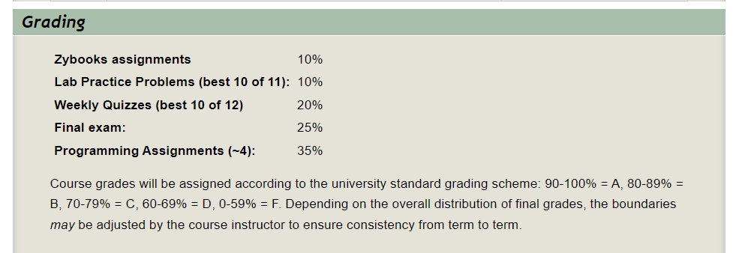
Read your syllabus!

Slide 9
Keep an eye on Pilot
Sunday | Tuesday | Thursday | Friday
Lab Prep Posted | Lab Problem Part 1 due | Lab Problem Part 2 due | New Zybooks homework posted Previous Zybooks homework due Weekly Quiz

Slide 10
Weekly Quizzes
Cover the big picture
Essential syntax and methods
You may bring a 2-sided notecard to each quiz
Two quizzes dropped, no re-takes except for documented emergencies

Slide 11
Class Technology
Bring your own laptop
ZyBooks
OneNote
Poll link
VS-Code, JDK 17, and extensions:
https://github.com/pattonsgirl/CS1180/tree/main#environment-setup

Slide 12

Where to get help
Your lab leader – email on Pilot
The CS Help room
https://engineering-computer-science.wright.edu/computer-science-and-engineering/help-room
My office hours
Make an appointment with me – michael.raymer@wright.edu
Discord # CS 1181

Slide 13
Tips for success
Code all the time
Come see me (In person!)
Ask questions
Design your code first
Fill in your pilot profile

Slide 14


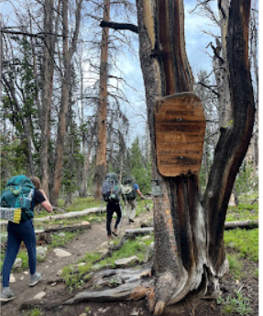

Class Exercise
Stuff I like

